Slide 1
Adams County Oil & Gas
Traffic Impact Study
Public Meeting
August 9th, 2017

Slide 2
Meeting Agenda
Presentation by Adams County and FHU
Table discussion and comments
Next steps
Close meeting

Slide 3
What is a Traffic Impact Fee?
Fee charged to new development used to pay for capital improvements required as a result of the new development
Required for traffic-generating development
  Single-family homes
  Commercial/industrial developments
  Proposed: Oil and gas

Slide 4
Background of Oil & Gas in Adams County
2014
  An increase in oil and gas development
2015
  Adams County adopted oil and gas regulations, with an MOU option (blanket agreement for all sites)
  An increase in large, multi-well pads
2016
  Adams County adopted oil and gas regulations requiring site-specific approval
  Board of County Commissioners gave direction to develop an oil and gas traffic impact fee

Slide 5
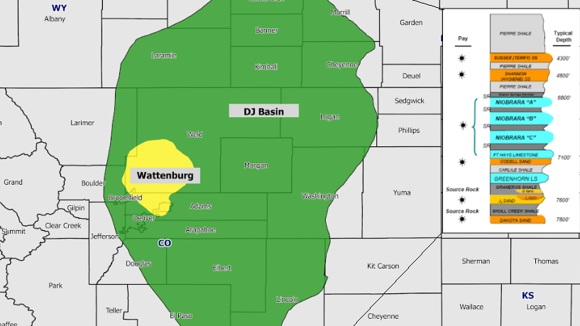
Shale Oil & Gas in Colorado
Credit:
http://www.shaleexperts.com/plays/niobrara-shale/Overview?menu

Slide 6
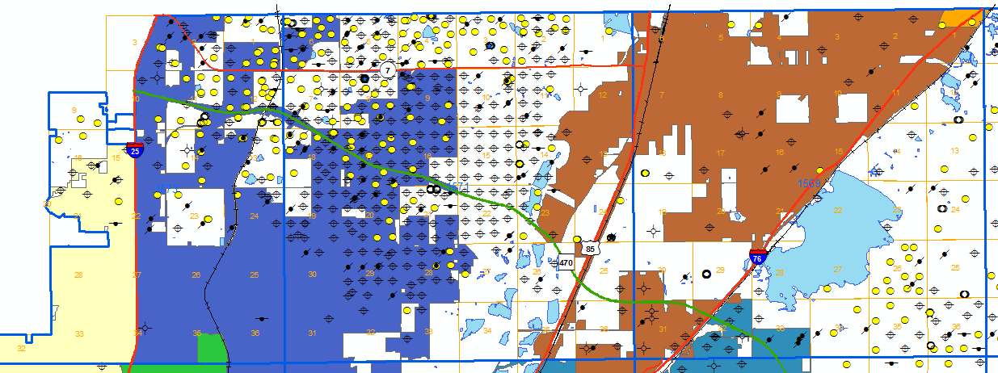
Northwest Adams County:
Historical Oil & Gas Development
Brighton
Thornton
Westminster

Slide 7
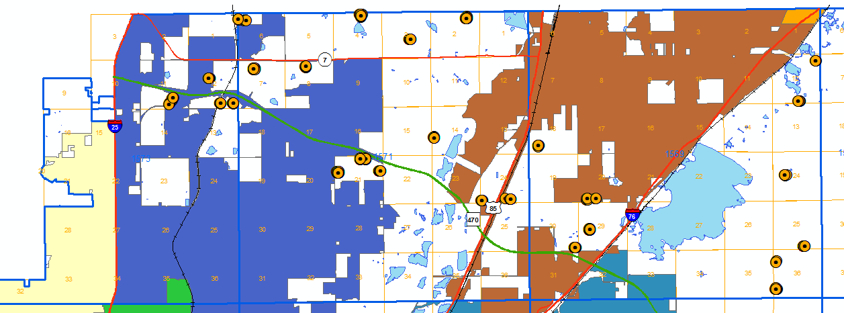
Northwest Adams County:
Current Oil & Gas Development
Brighton
Thornton
Westminster

Slide 8
Drilling
Trend
Horizontal drilling allows for consolidation of many wells on a single pad site
Results in a consolidation of impacts

Slide 9
Study Objectives
Identify potential impacts of oil and gas industry on Adams County’s roads
Estimate general magnitude of:
  Oil and gas related truck traffic
  Incremental road deterioration
  Multimodal safety needs
Calculate an impact fee to allow the County to offset increased road deterioration and multimodal safety costs

Slide 10
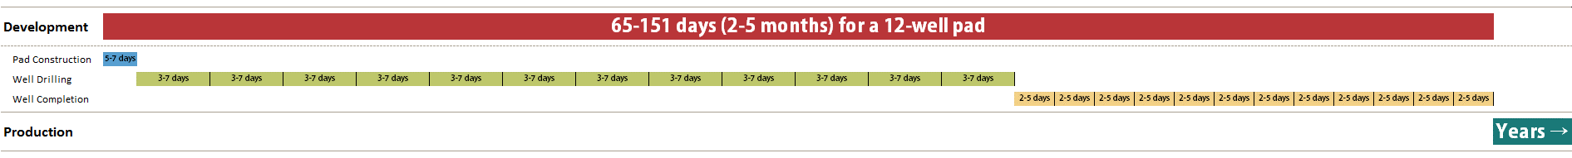
Oil & Gas Activity Overview
Development phase (once lease and exploration complete):
  Pad construction – 5-7 days total
    Preparing the site, including building the access road and the well pad.
  Drilling – 3-7 days/well
    The process of drilling the well to the desired depth and completing the requisite number of horizontal bores.
  Completion – 2-5 days/well
    Converting the well system to a producing well, typically by fracturing the shale and completing the production well requirements. Removing flowback water from the well pad.
Production phase (extracting, storing and distributing the resource)

Slide 11
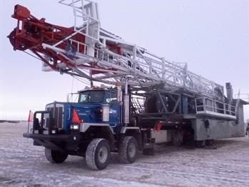
Elevated Impacts
Vehicle: | Passenger Car | Water Tanker | Specialized Trucks
Unit: | 1 | 1 | 1
Weight: | 1 | 20 x a car | 40 x a car
Impact: | 1 | 2,000-6,000 x a car | 15,000-46,000 x a car
Credit: PACCAR Inc

Slide 12
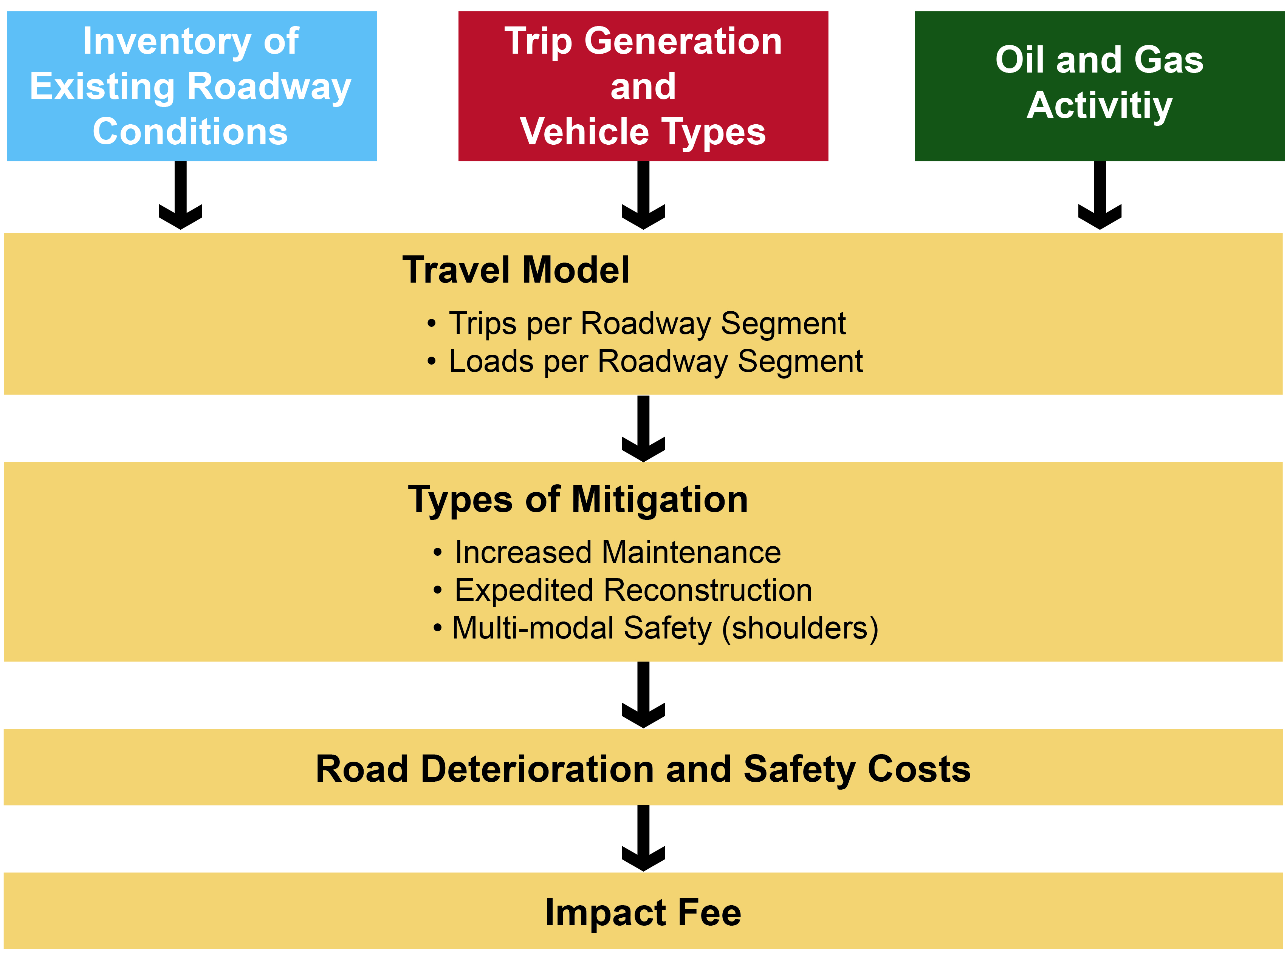
Study
Process
Notes:
Uses existing County road network and conditions
Uses studies from Colorado and around the country for trip generation, truck types, truck weights, etc.
Considers development possibilities across all of unincorporated Adams County
Assesses roadway needs only for roads that Adams County is responsible for
Looks at development and production phases
Development: pad construction, drilling, and completion
Production: 10 years
Uses transportation engineering standard calculations to determine oil and gas industry’s proportional share of road deterioration and multimodal safety costs

Slide 13
Mitigation Activities Included
Paved roads
  Additional asphalt overlay to offset impacts
  Expedited reconstruction due to faster expiration of service life
  Adding shoulders to offset impacts to multimodal safety
Gravel roads
  New gravel
  Additional grading
  Increased dust suppression applications
  Paving (> 400 ADT)

Slide 14
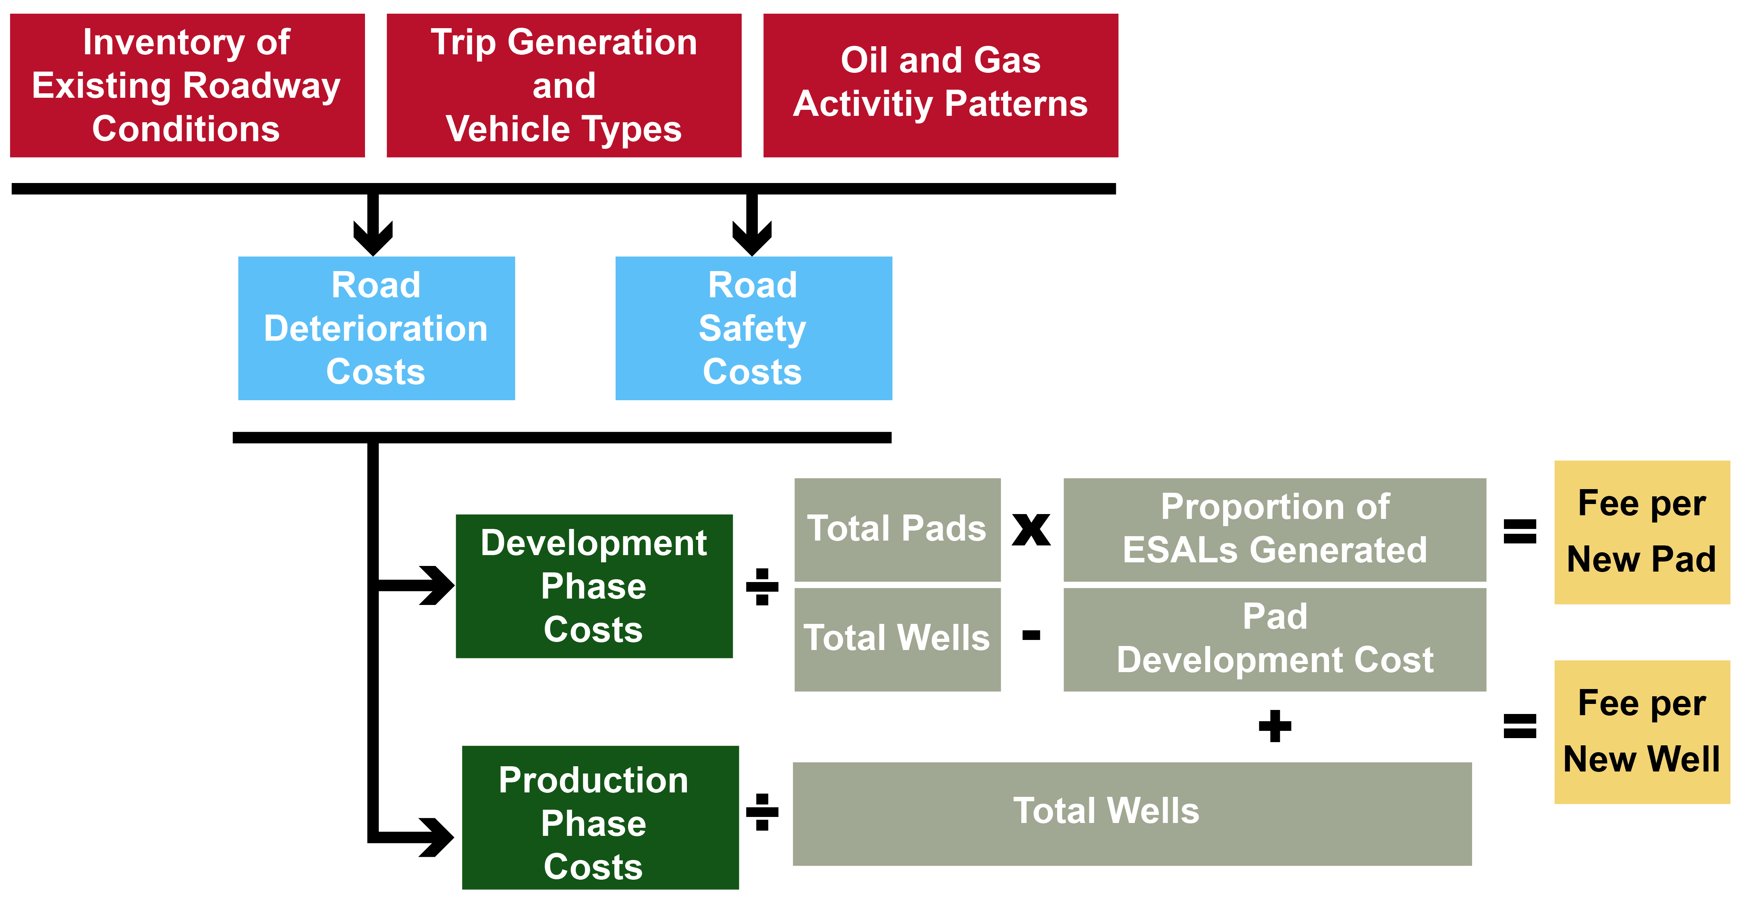
Fee
Calculation Methodology

Slide 15
Next Steps
Public and stakeholder outreach
Next meeting dates:
Public Hearings before the Board of County Commissioners
Public Involvement Meetings
Date & Time | Participants | Location
8/9/17 from 6-7:30pm | Public | Eagle View Adult Center
8/16/17 at 6:30pm | Oil & Gas Operators | Eagle View Adult Center
8/21/17 from 6-7:30pm | Public | Eagle View Adult Center

Slide 16
Questions?
Thank you for coming!

